Slide 1

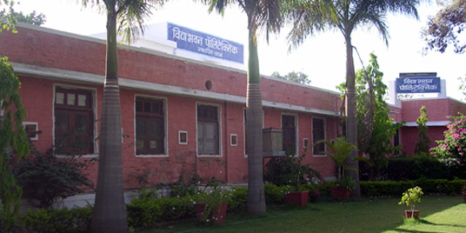

Welcome to Vidya Bhawan Polytechnic College, Udaipur
Department of Computer Science & Engineering

Slide 2

Online Blood Bank Management System

Slide 3



Group Members:
Vaibhav kumawat [GL]
Naresh Mali
Bhavesh Nagda
Vijay Kumar Jhalora

Slide 4






Introduction
Through this website any person who is interested in donating the blood can register himself in the same way if any organization wants to register itself with this site that can also register.
Online Blood Bank is aims serving for human welfare. We have all the information, you will ever need. Many people are here for you, to help you, willing to donate blood for you anytime

Slide 5
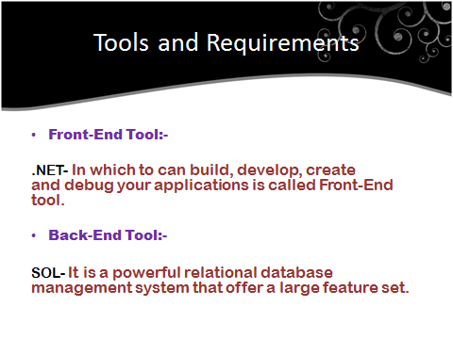

Slide 6
Asp.Net
Since 1995, Microsoft has been constantly working to shift its focus from windows-based platform to the internet As a result, Microsoft introduced ASP (Active Server Page) in November along with a new level of simplicity that made bit easy to understand and use.
.NET is a programming language. The main goal of .NET is to make it easier to develop application that run over the internet

Slide 7

Microsoft SQL server is a very popular and broadly situated general purpose database server supported on Windows server operating system.
Microsoft SQL server is a relational database management system developed by Microsoft. As a database, it is a software product whose primary function is to store and retrieve data.
Features
Adding empty files to the database.
Inserting new data into the existing files.
Retrieving data from the files.
Update data in the files.
Deleting data from the files.
Removing files from the database.

Slide 8

Hardware and Software Requirements
Client Side Requirements:
Processor | Pentium (Dual core or i7 suggested)
RAM | 512MB (8 GB suggested)
Memory | 10GB (1 TB suggested for long term use)
Web Server | IIS (Internet Information services)
Server Side Requirements:
Processor | Pentium (Dual core or i7 suggested)
RAM | 512MB (8 GB suggested)
Memory | 10GB (1 TB suggested for long term use)
Web Server | Internet Explorer 7.0 or Higher

Slide 9
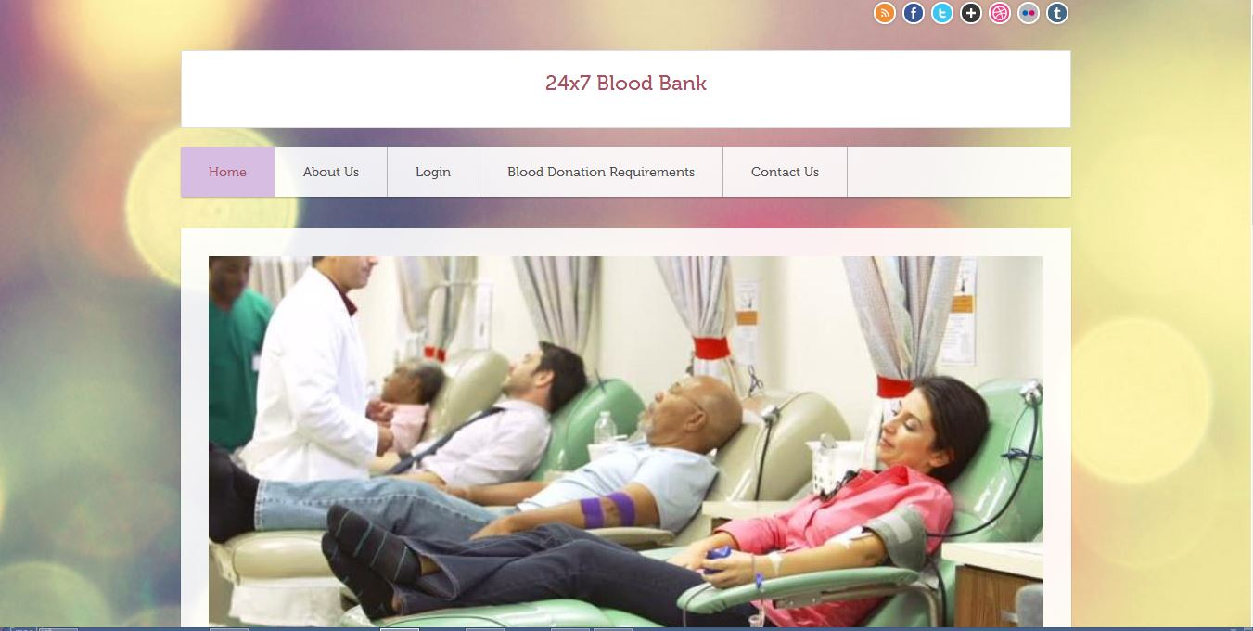
Index Page

Slide 10
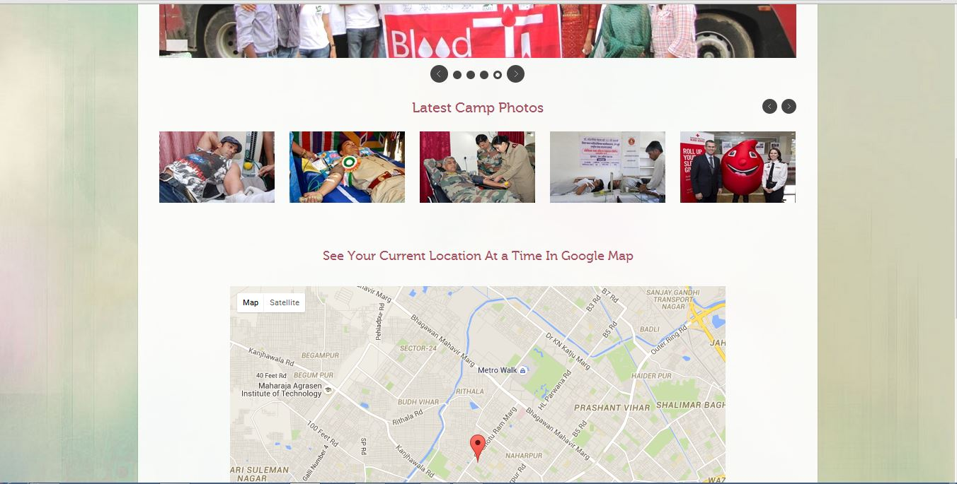
Index Page

Slide 11
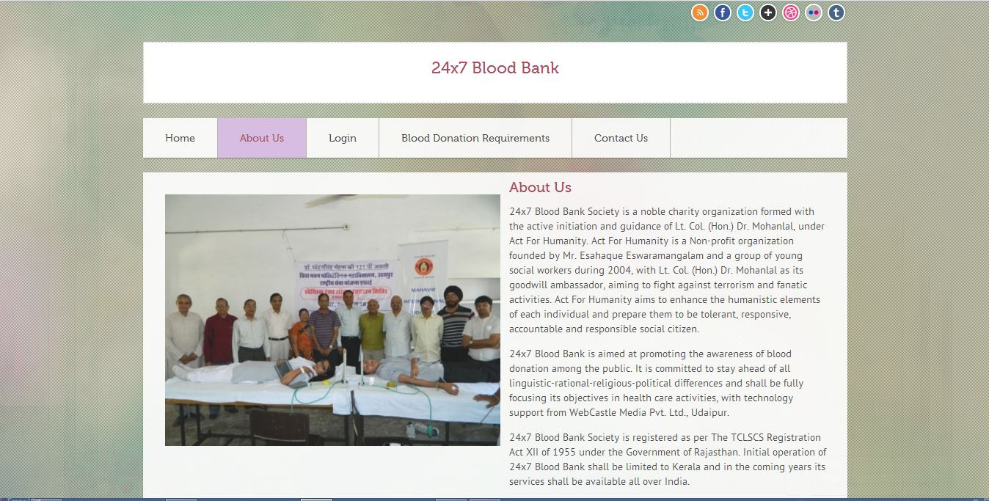
About Us Page

Slide 12
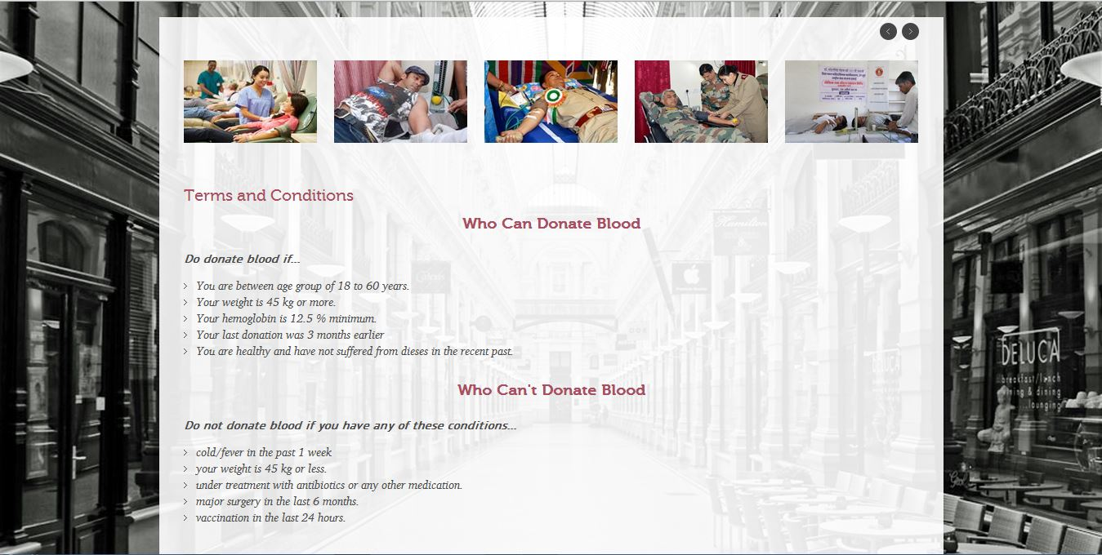
Blood Donor Requirements

Slide 13
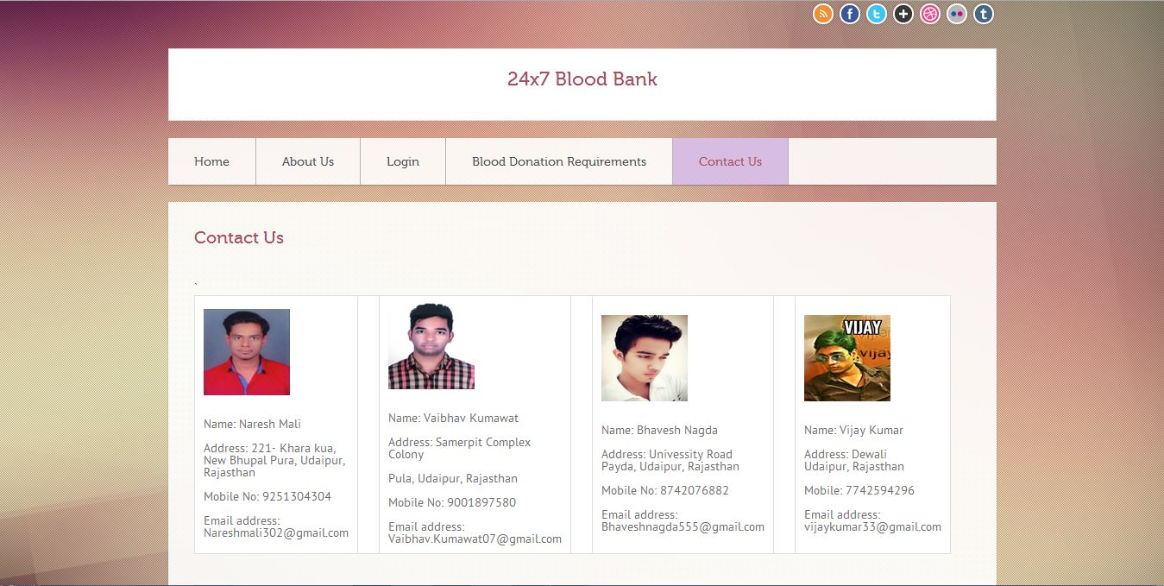
Contact Us

Slide 14
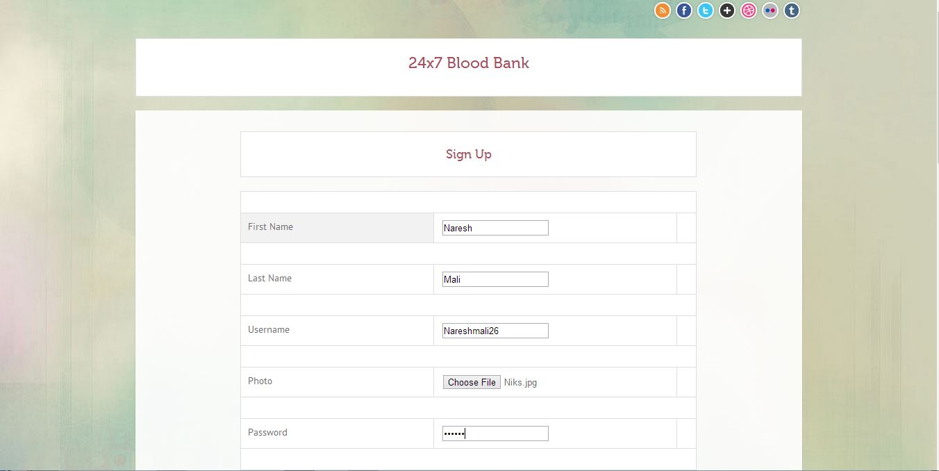
Sign Up

Slide 15
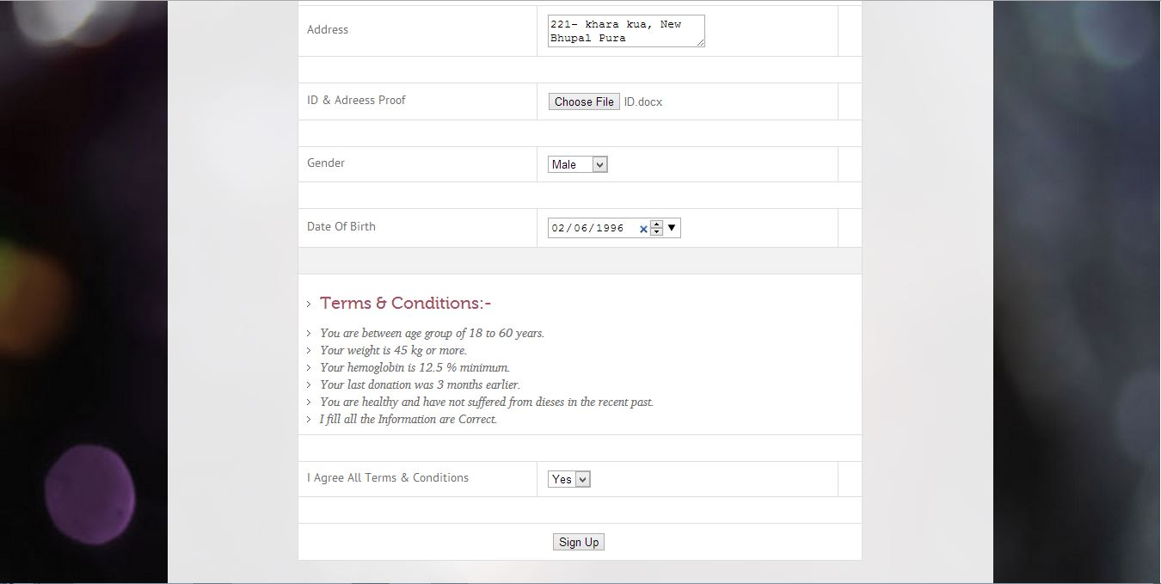
Sign Up

Slide 16
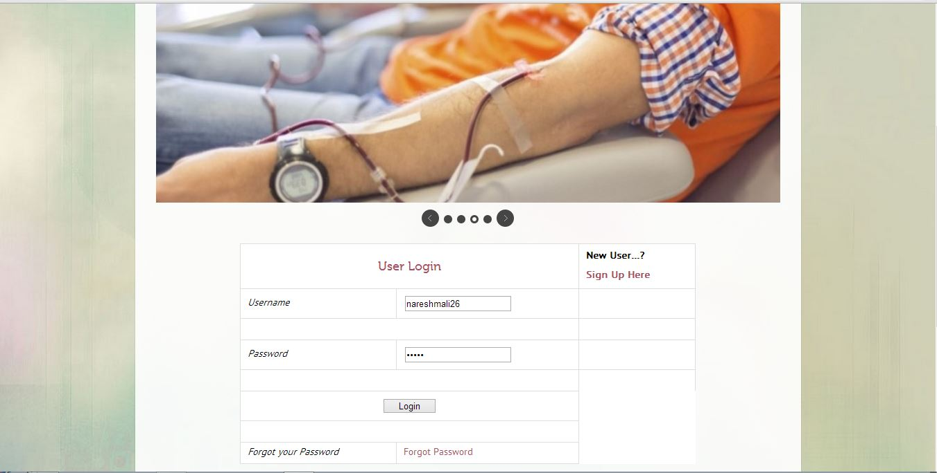
Login Page

Slide 17
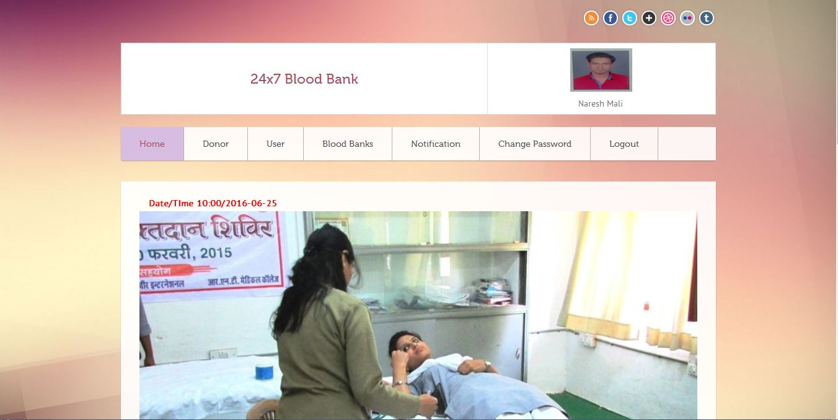
Home Page

Slide 18
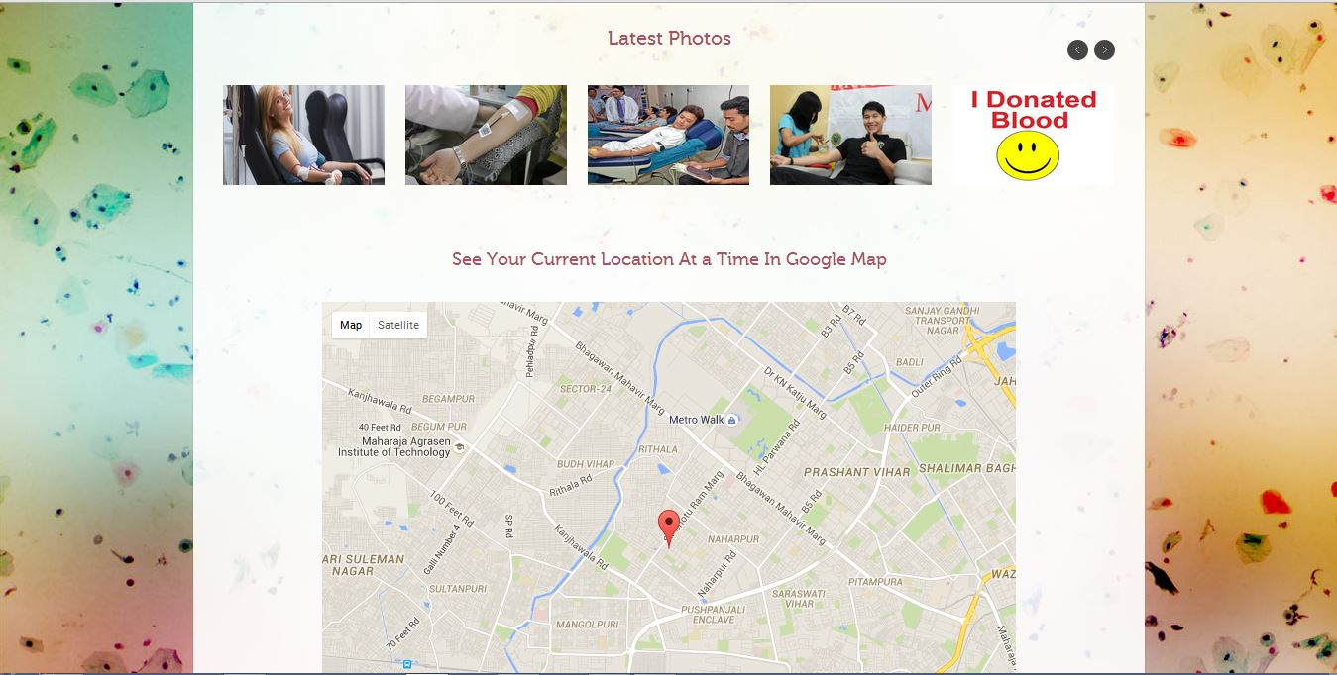
Home Page
Home Page

Slide 19
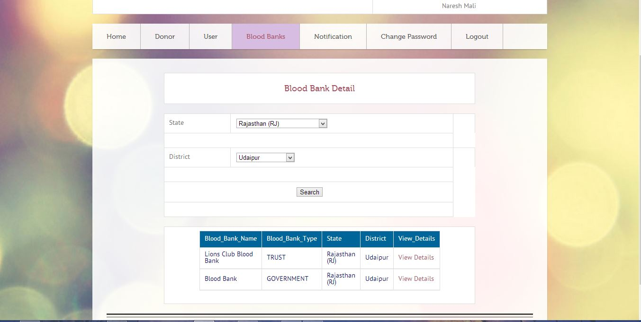
Blood Banks

Slide 20
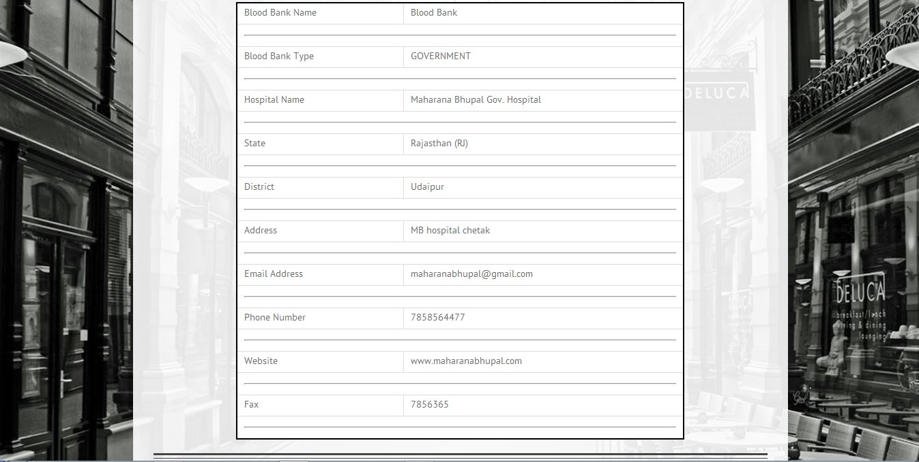
Blood Bank Detail

Slide 21
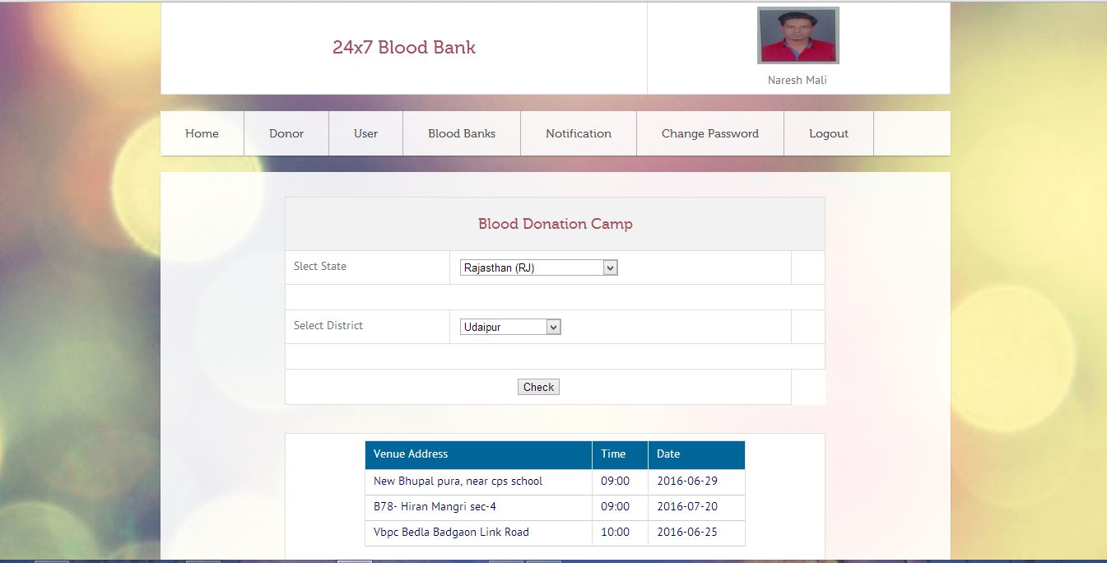
Camps

Slide 22
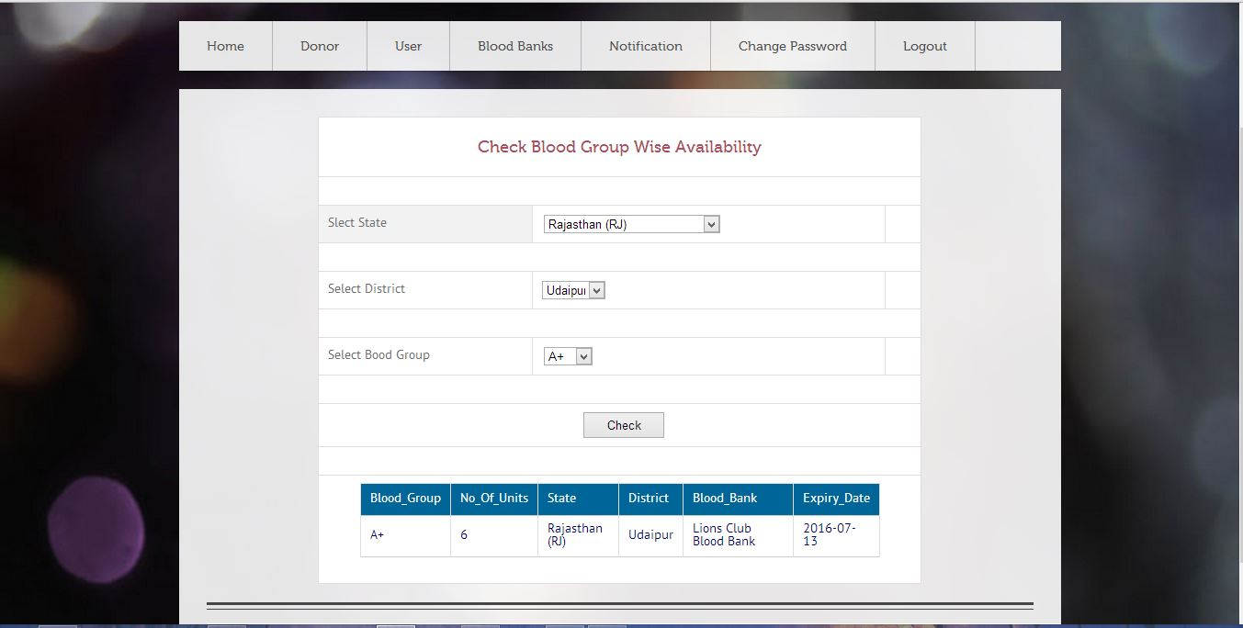
Blood Availability

Slide 23
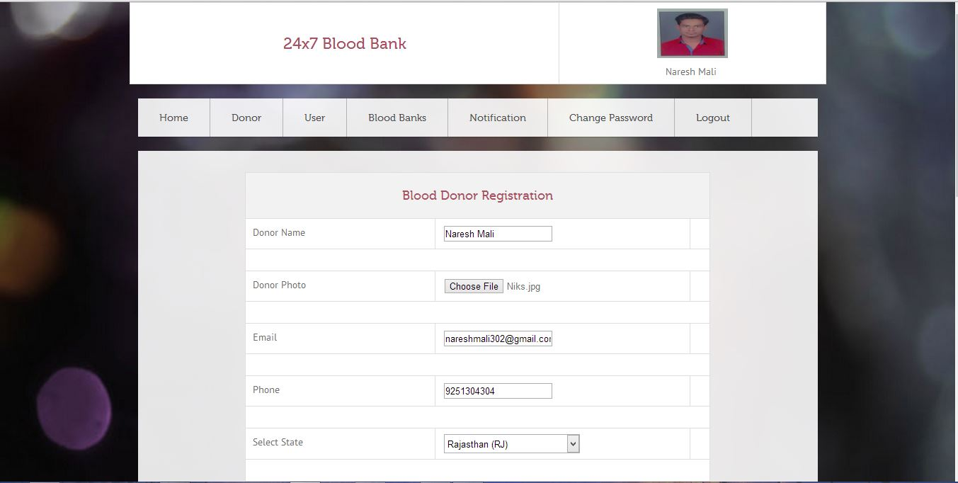
Blood Donor Registration

Slide 24
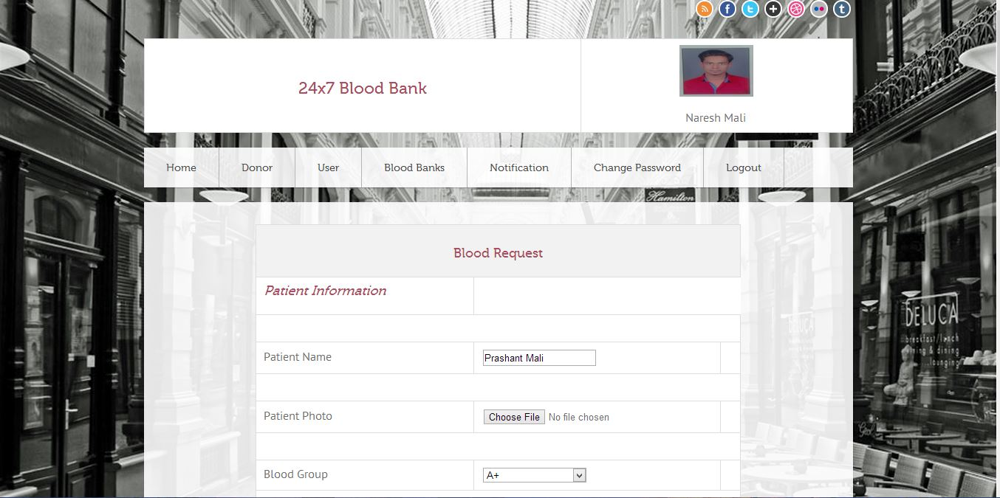
Blood Request

Slide 25
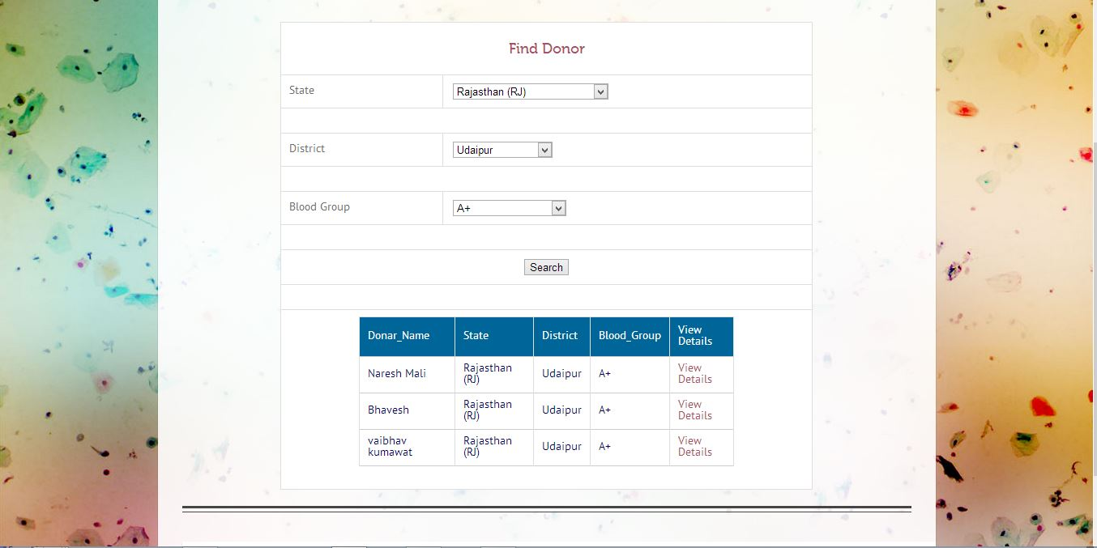
Find Donors

Slide 26
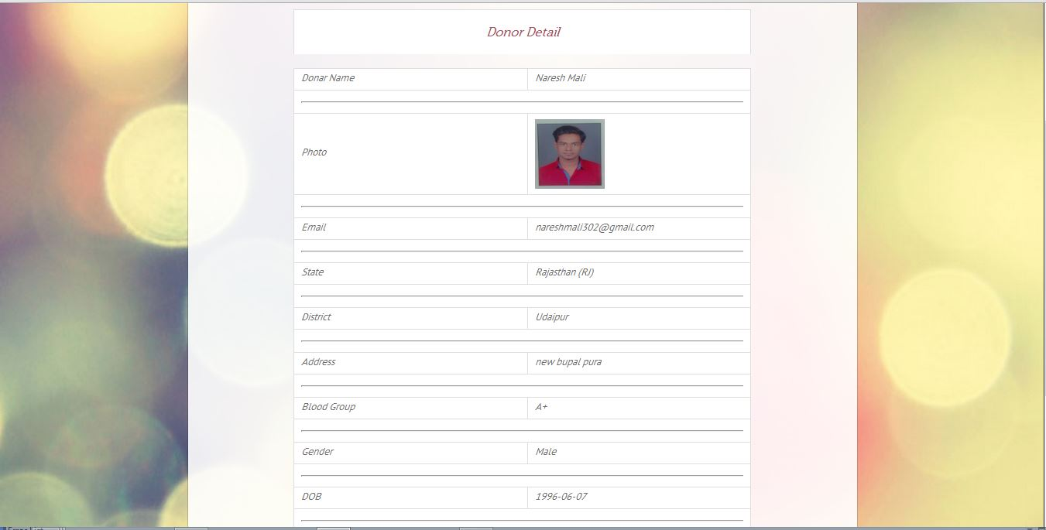
Donor Details

Slide 27
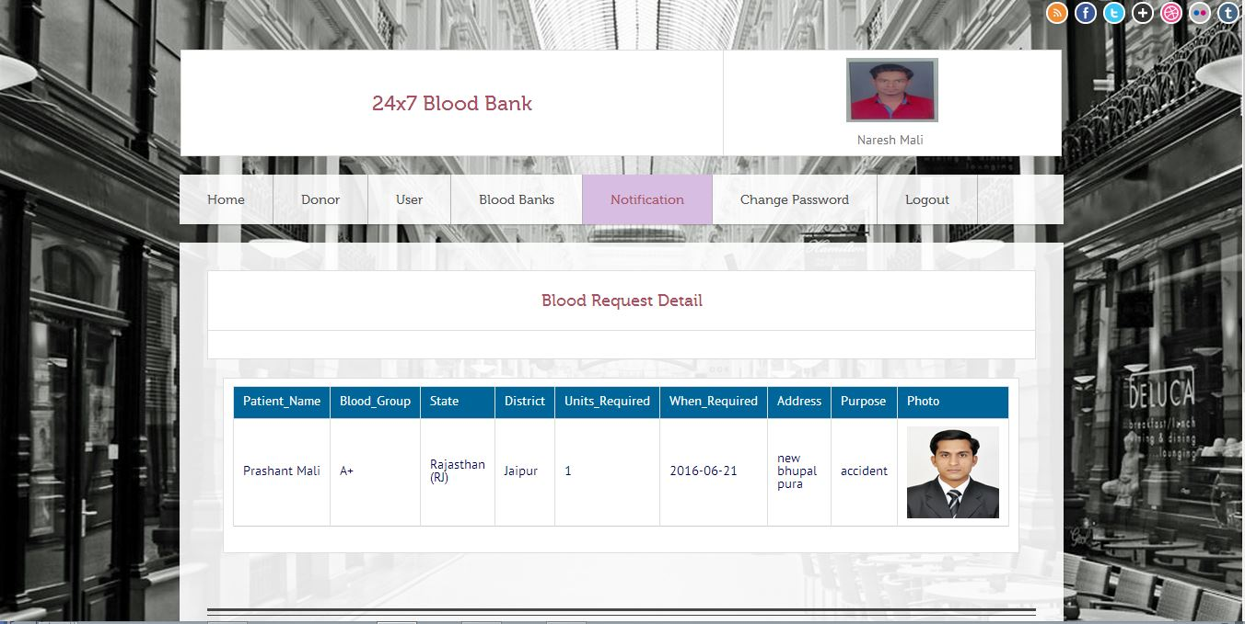
Notification

Slide 28
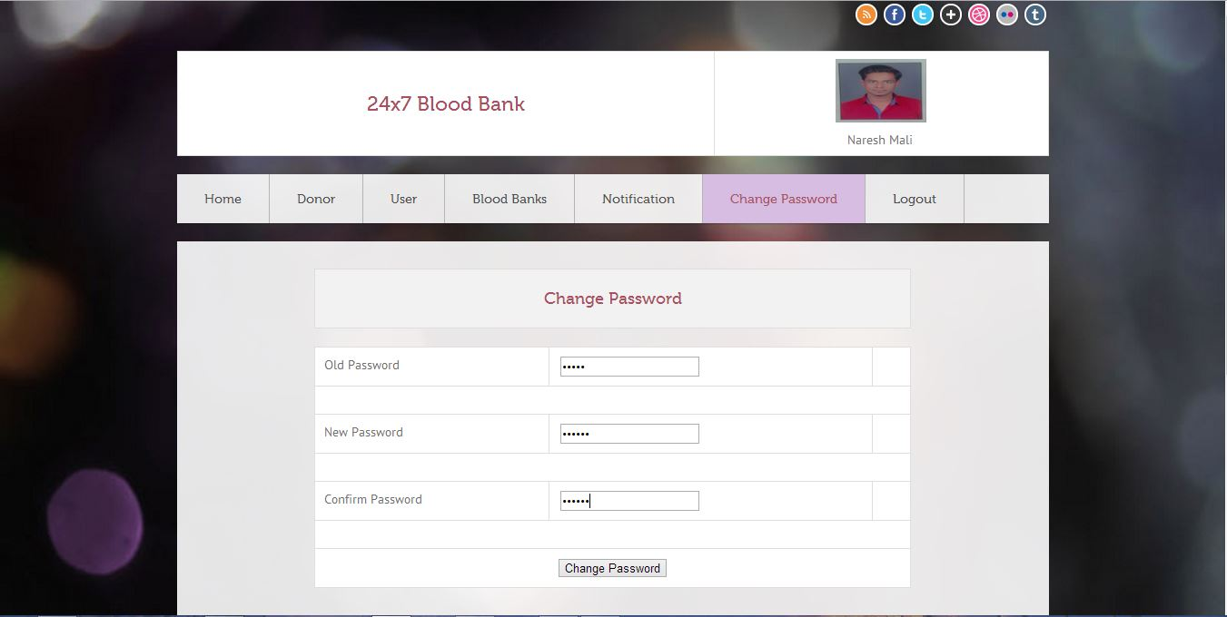
Change Password

Slide 29
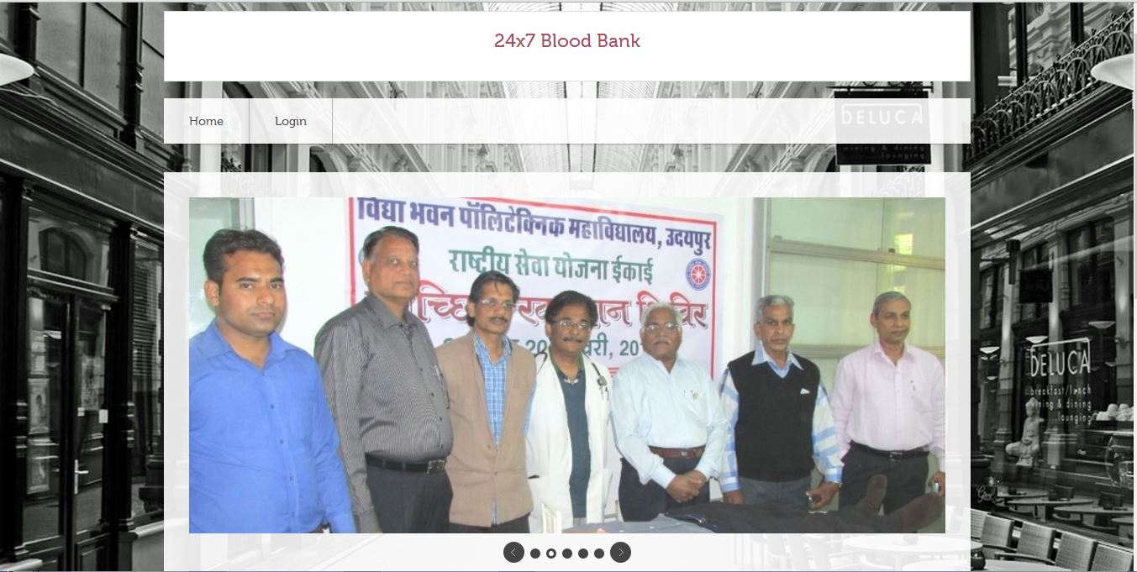
Admin Index Page

Slide 30
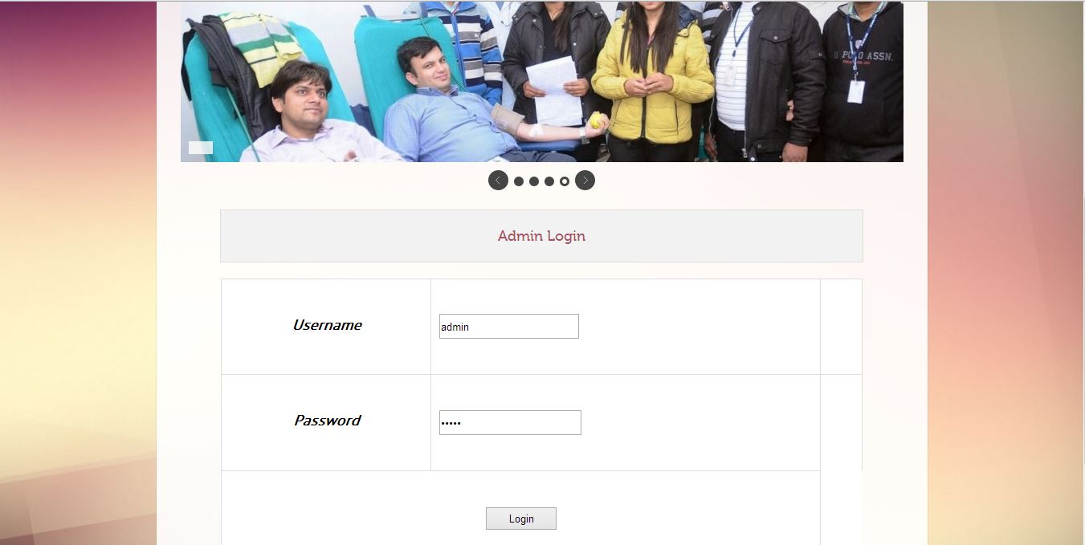
Admin Login

Slide 31
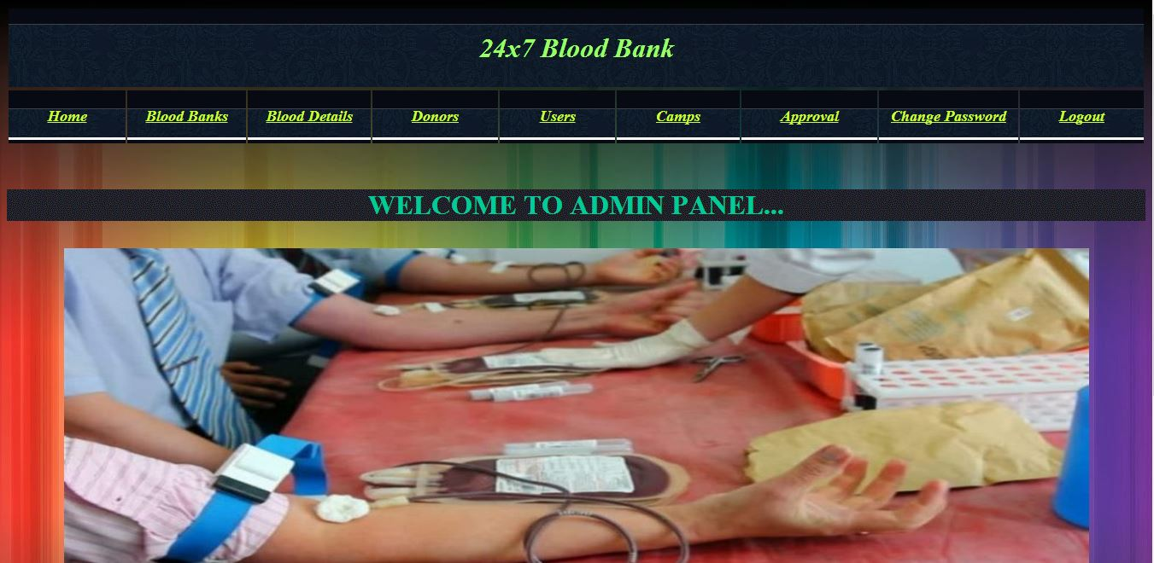
Welcome To Admin Panel

Slide 32
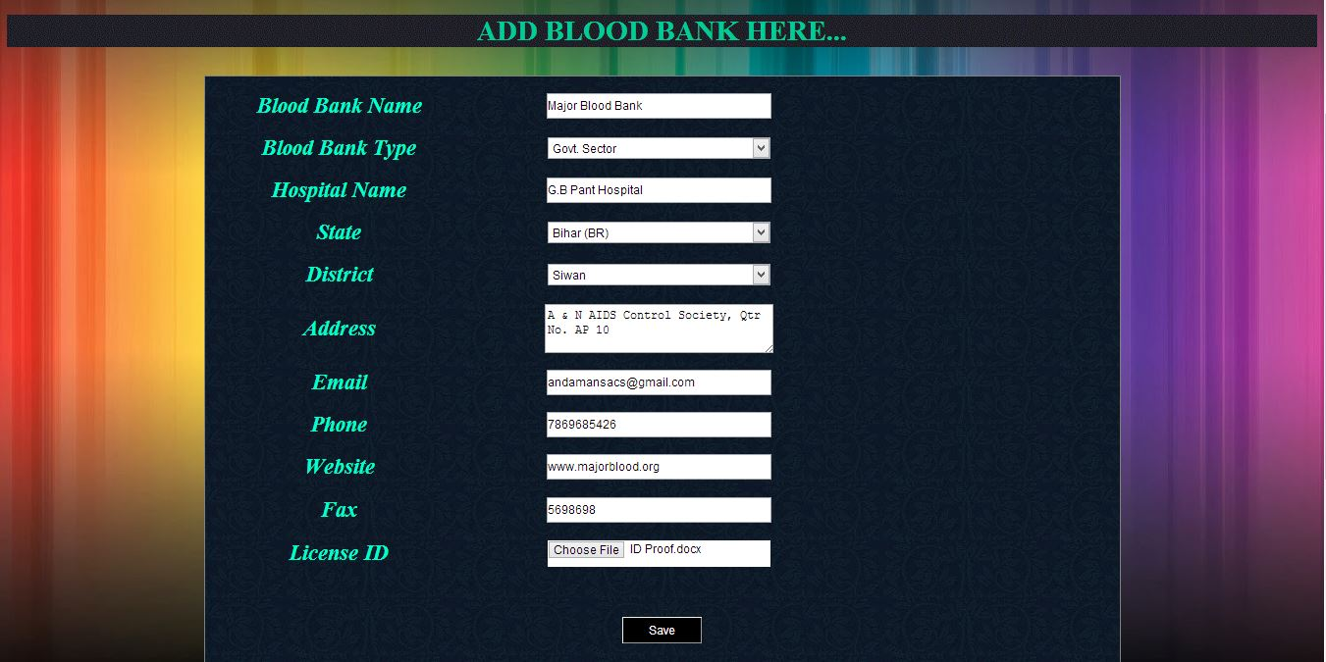
Add Blood Banks

Slide 33
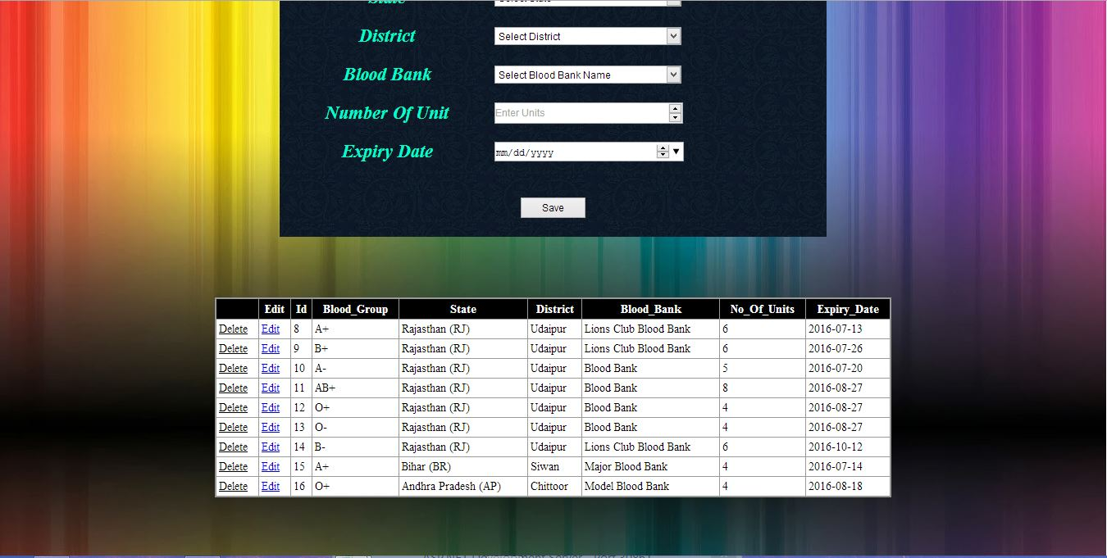
Blood Bank Details

Slide 34
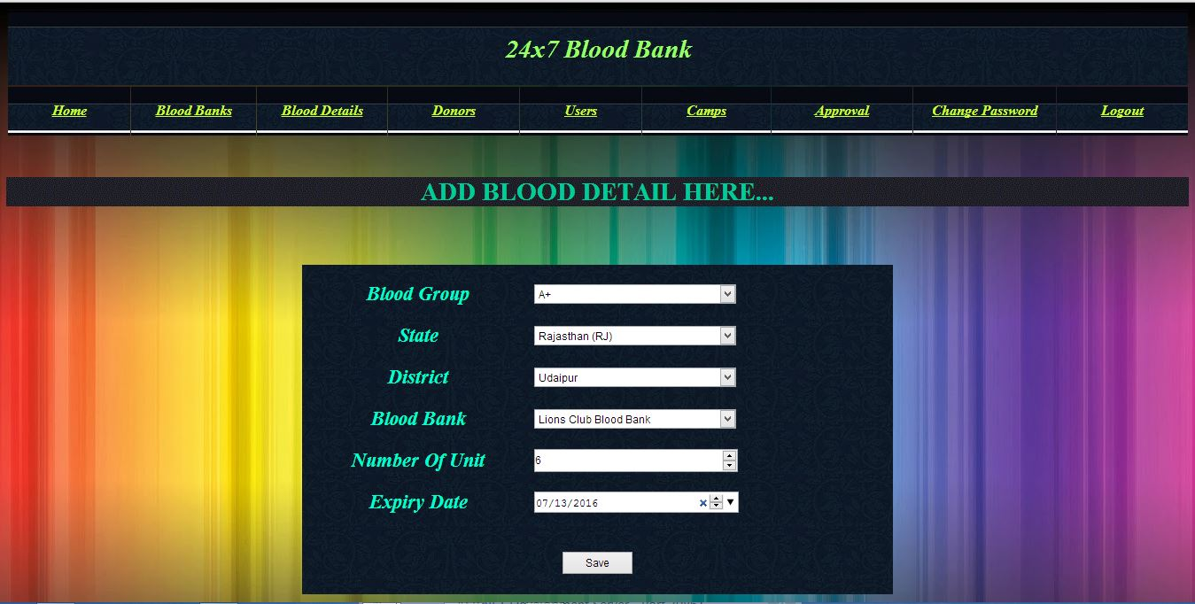
Add Blood Details

Slide 35
Blood Details

Slide 36
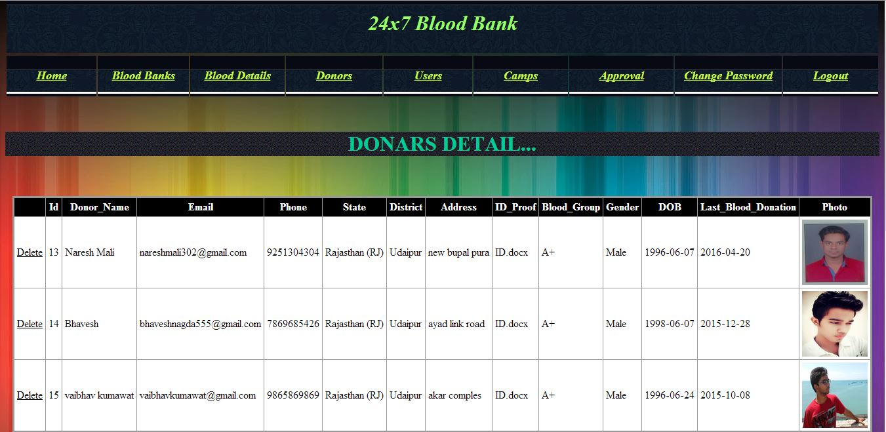
Donors

Slide 37
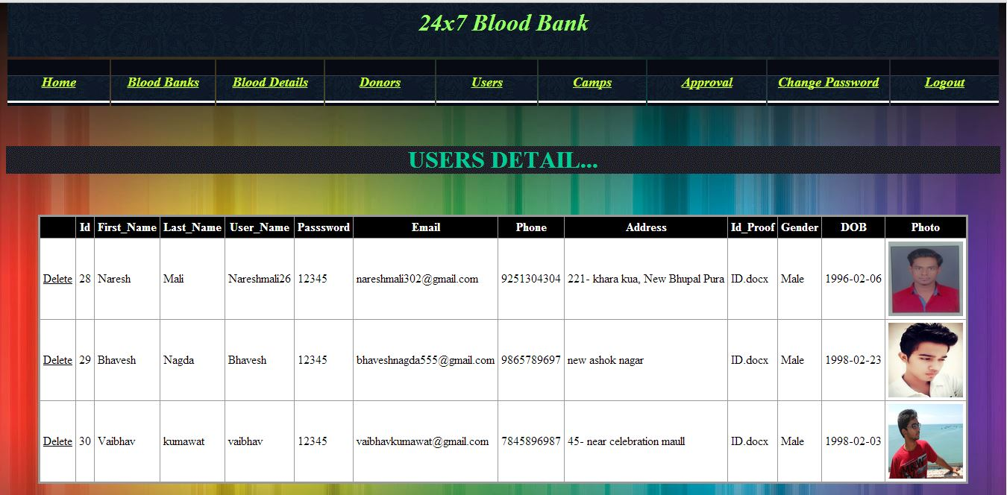
Users

Slide 38
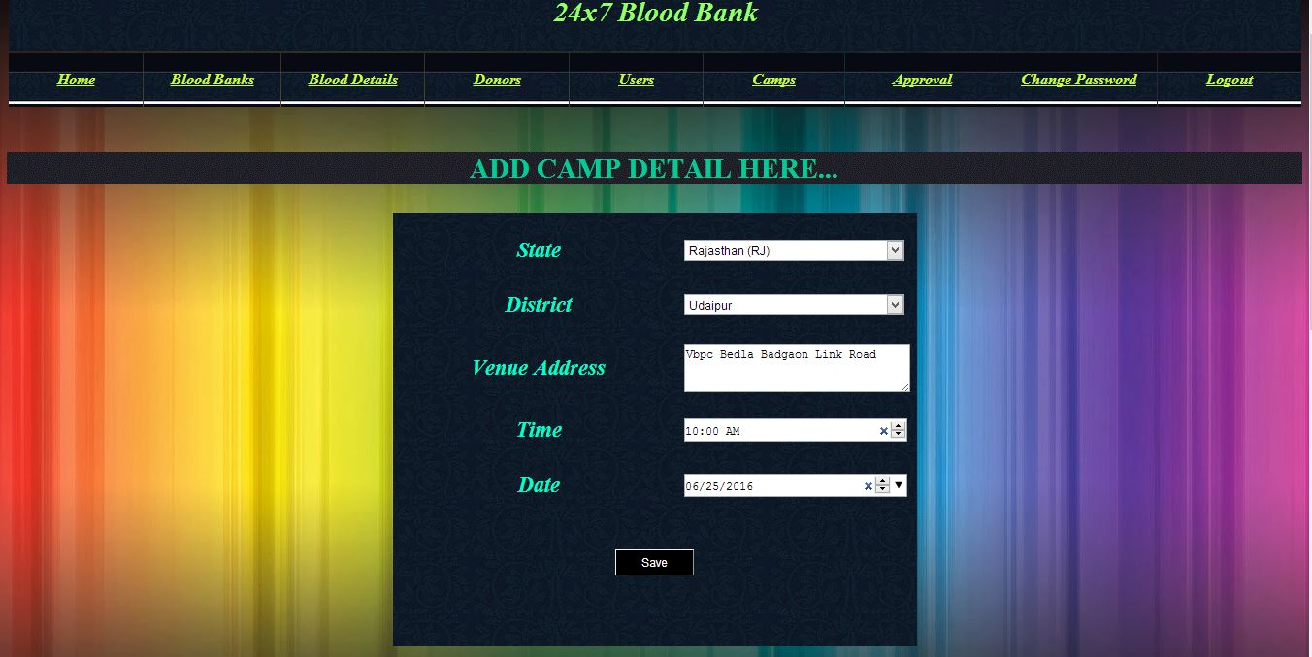
Add Camps

Slide 39
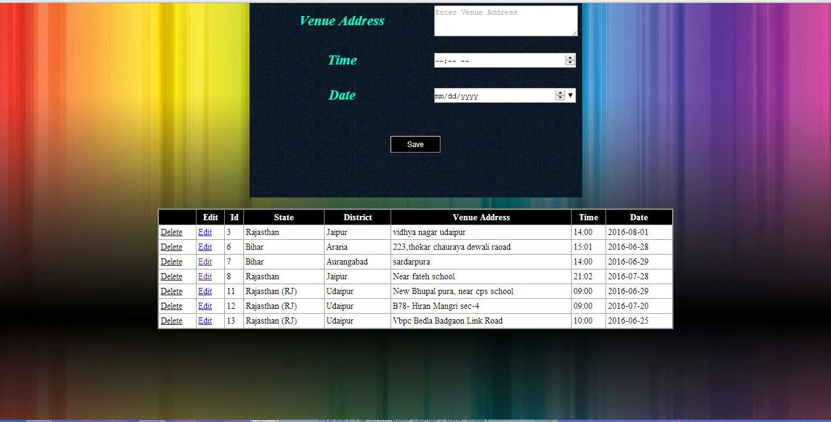
Camp Details

Slide 40
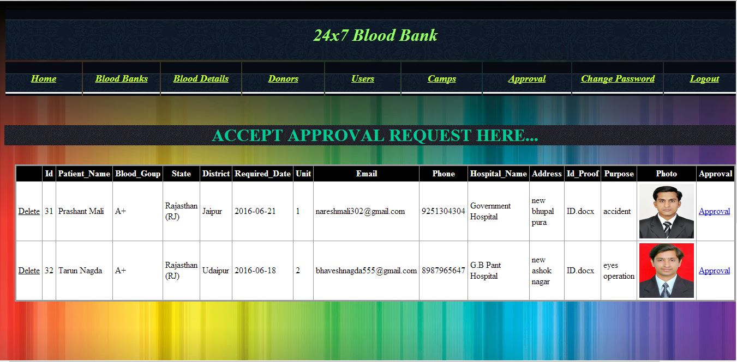
Approval

Slide 41
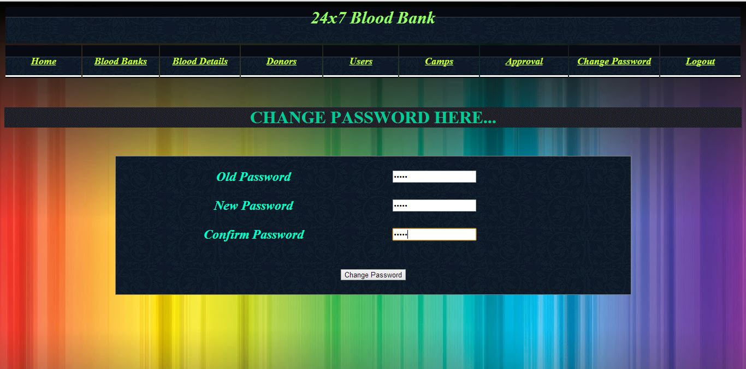
Change Password

Slide 42



